Slide 1
Information Security
Changing State of Threats and Vulnerabilities
FIRMA
March 30, 2010

Slide 2
Information Security 2010
2009 Recap
Evolving Threat – How bad is it?
Changes to Regulatory and PCI Requirements
What are we doing about it?
What should we be doing about it?
What should you be auditing for?

Slide 3
2009 Recap
Most data breaches externally driven
99% of breaches electronic data
69% discovered by third party
Human-error and multiple issues allows vulnerability
Targeted
Malware-driven
Data Breaches (in 1000s)
Causes

Slide 4
2009 Recap
Retail and Online-61%
Financial Services-93% or records breached
The Castle and the Villagers
Zeus – Key Stroke Loggers
Systemic Failures
Targeted Sectors
Synopsis

Slide 5
Trend
Threat Categories over time by percent of breaches

Slide 6
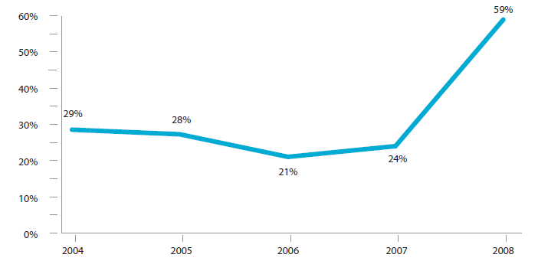
Trend
Malware customization by percent of breaches involving malware

Slide 7
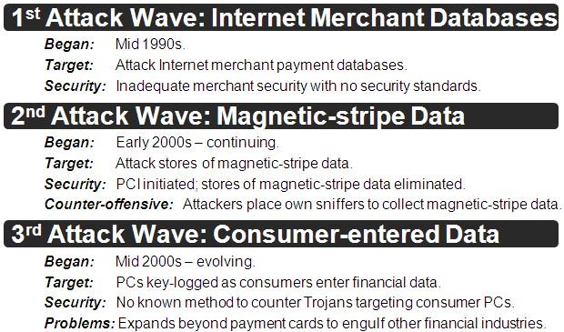
Changes in Attack Trends

Slide 8
Why is this so hard?
Readily-available Trojans Toolkits: High-quality trojan toolkits are readily available (~$700) and easy to use.
Toolset Trojans Have Unique Signatures: Trojan toolkits create a new binary file (.exe) for each generated trojan. Therefore, each has a unique signature, making them highly resistant to detection.
Botnet Service Industry: Bot herders lease existing botnets for agreed periods of time, providing the harvested data from the renter’s trojan.

Slide 9
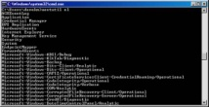
“Data Harvesting” Crimeware*
*
Crimeware is a class of malware targeting PCs that is specifically designed to automate large-scale financial crime.
WEBSITES
INFECTING
WEBSITES
INJECT
TROJANS
Anti-virus & Firewalls Fail to Counter Crimeware
INFECTED
PCs (BOTs)
EXPORT
KEY LOGs
KEY-LOG
COLLECTORs
PARSE/SORT
KEY-LOGs
SORTED
KEY LOGs
Sorted by Bank
Sorted by Business
Sorted by Issuer
Bank Account Logons
(Logon, Security Questions)
$Management Logons
(Logon, Security Questions)
Payment Card Data
(Card #, CVV2, Expire Date)

Slide 10
Regulatory/PCI/Litigation
2005 FFIEC Internet Authentication Guidelines
2006 Federal Judiciary – E-Discovery
2006 FFIEC Information Security Update
The rise of State breach notification laws
2009 PCI v1.2 update
2010 Expert-Metal vs Comerica Bank

Slide 11
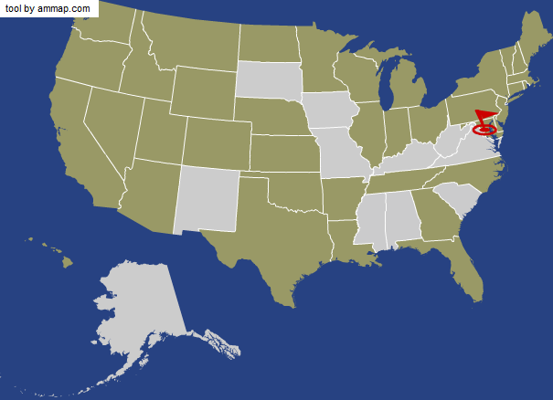
State Breach Notification Laws
http://www.csoonline.com/article/221322/CSO_Disclosure_Series_Data_Breach_Notification_Laws_State_By_State

Slide 12
What are we doing about it?
Ongoing layered security development
Security Questions for Anomalous Behavior
Second Factor Authentication for High-Risk Transactions (ACH – Wire Transfers)
Mitigation of PCI non-compliance items

Slide 13
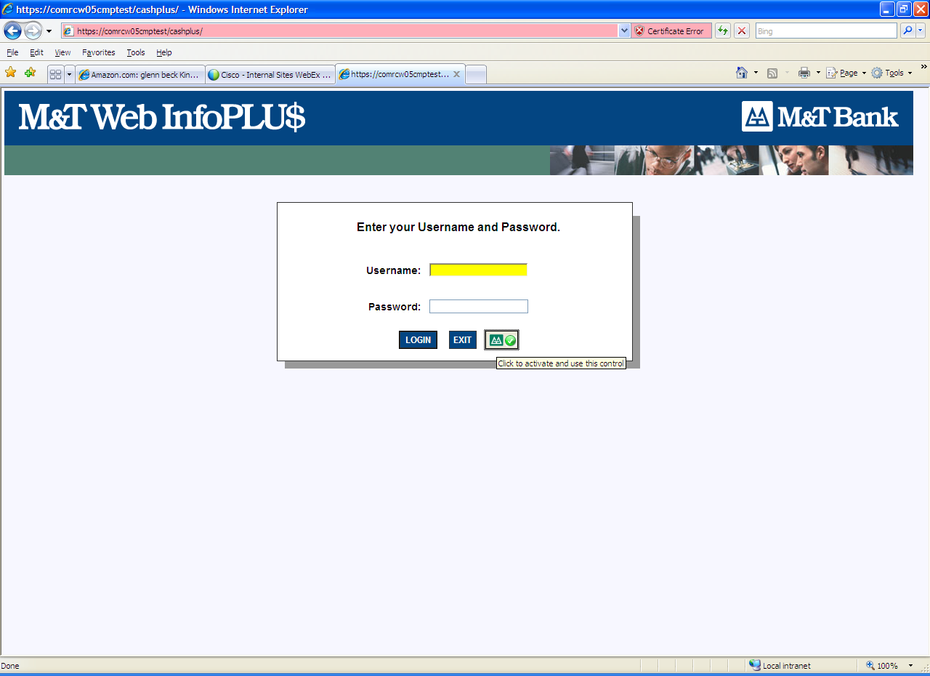
Form Field Protection
Form Field protection from Key-stroke loggers
Non-intrusive Active-X control

Slide 14
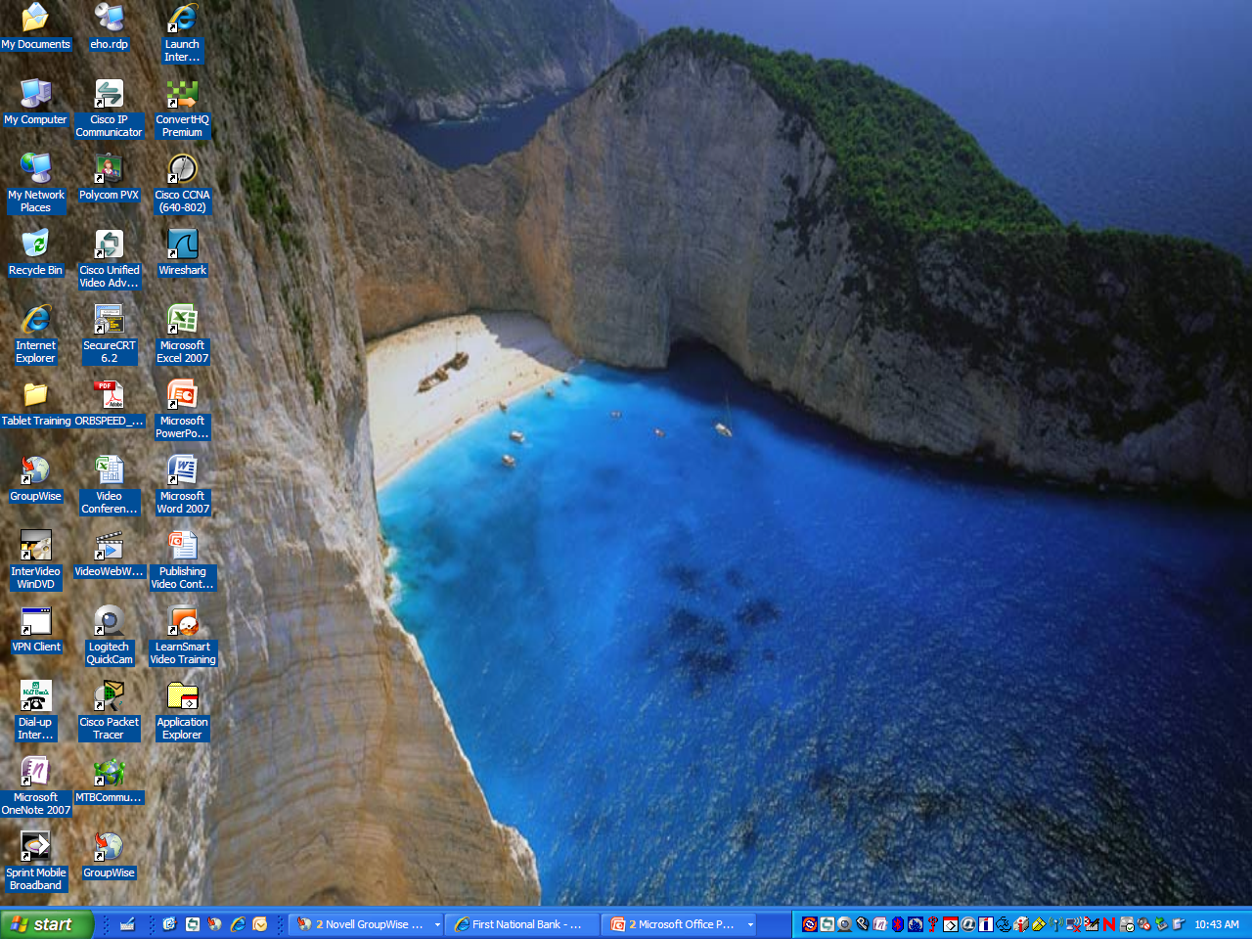
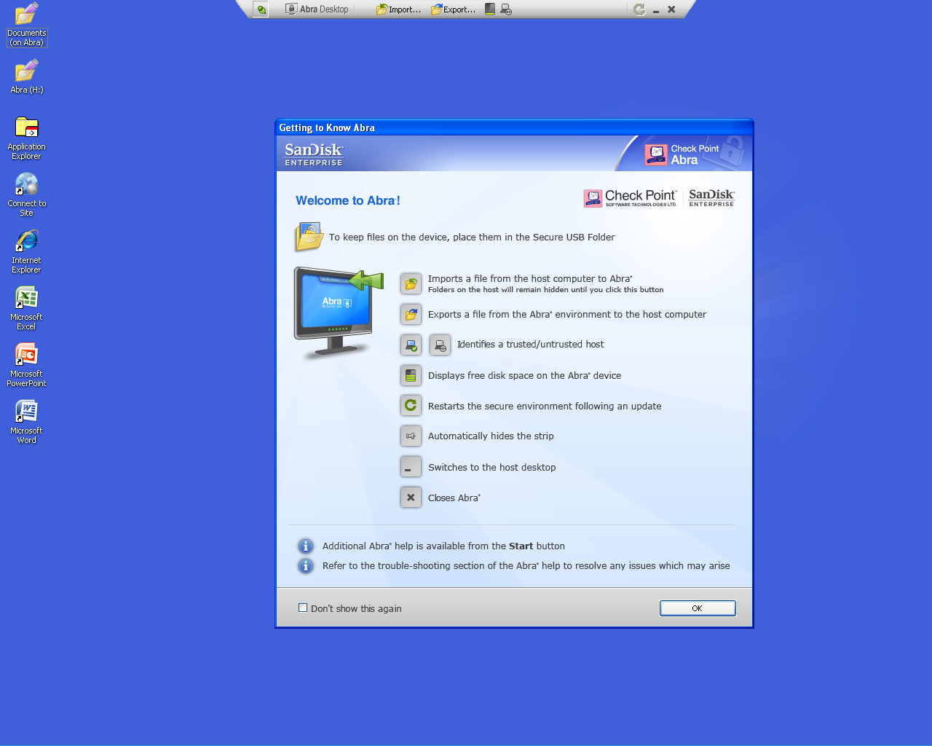
Secure Virtual Concept
Ability to Import/Export documents into secure environment
Ability to pre-define the websites the customer can use
Virtual Desktop operates within customer environment
Secure environment protects customer interactions with M & T Bank

Slide 15
What should we be doing?
Have no expectation of the customer
Regulatory and association rules must develop to consider third-party malware
Fraud intelligence gathering
International law must be modified to remove cyber-attack “safe havens”
Change the security paradigm

Slide 16
What should you be looking for?
Loss vs loss avoidance trends
Layered security architecture
Firewall/IDS/IPS
Evidence of continual penetration testing
Aggressive OS patching program
Up to date software
Evidence of compliance
Certified Forensic Examiners

