Slide 1
Ponzi Rides Again (and Again)
24th Annual FIRMA National Risk Management Training Conference
Jonathan E. Turner, CFE, CII

Slide 2
Ponzi Schemes Unflagging Success
Today’s Agenda
  Why Are Ponzi Schemes Successful?
    They are Well Known
    Well Documented
    Demonstrate Clearly Defined Characteristics
  Why are They So Popular?
  Why Are We Not Stopping Them?
  What are the Lessons for Fraud Examiners?

Slide 3
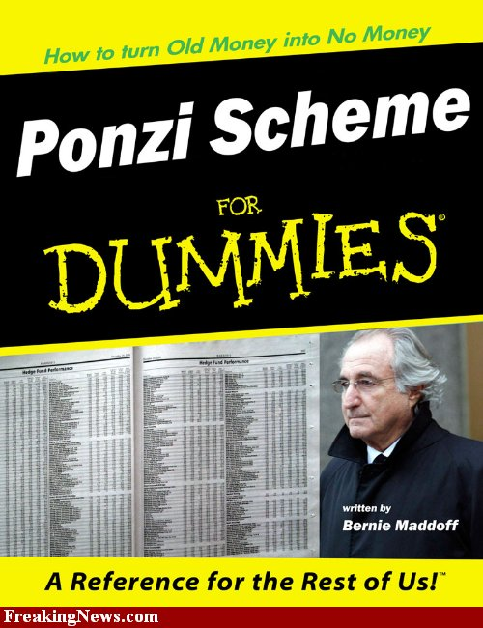

Slide 4
History of the Ponzi Scheme
Named for Carlo “Charles” Ponzi in the 1920’s.
  Required Elements:
    Trust
    Precision
    Spin

Slide 5
Understanding Success
Bridging the Theoretical
Relying on Greed
Dependence on Secrets/Expertise
Providing Profits
Defying Disbelief
Demonstrating Results

Slide 6


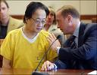

Norman Hsu - $60,000,000

Slide 7



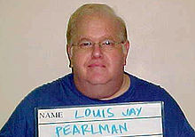





Louis J Perlman - $300,000,000

Slide 8
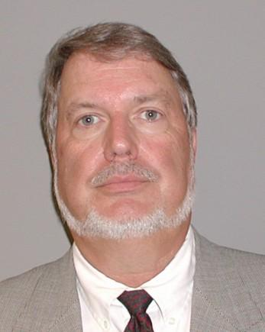
Lance K. Paulsen - $3,000,000,000

Slide 9

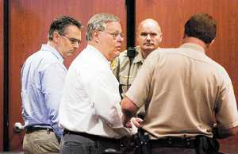
William Crotts & Thomas Grabinski
$585,000,000

Slide 10

Martin Armstrong - $3,000,000,000

Slide 11
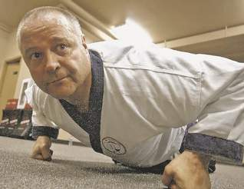
Nicholas Palazzo - $800,000

Slide 12

Some Others Worth Noting:
Kenneth Kasarjian - $1,500,000,000
Steven Hoffenberg - $450,000,000
Nicholas Cosmo - $370,000,000
Arthur Nadel - $300,000,000
Joseph Forte - $50,000,000

Slide 13
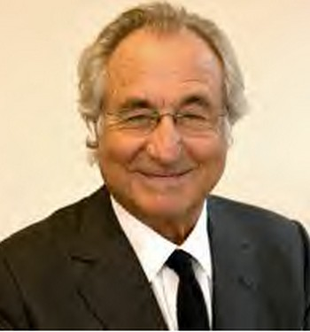
Not To Mention …

Slide 14

Elements of Ponzi Scheme
Investors
Investors
Perpetrator – Shhhhhhhh!!!!!!

Slide 15
Why they Are Popular
There are none so blind as those that will not see
There is no upside to finding them
Proof requires convincing the many of what they do not want to believe
Each element, taken in a vacuum could be possible
Time, Time, Time, Time

Slide 16
Reasons for Their Success
They are Set Up As Businesses
They Provide a Needed Solution
They Rely on Statistics
They Have an Exit Strategy
They are Sold

Slide 17
The Business Component
Businesses involve Risk
Successful Entrepreneurs Manage Risk for Profit

Slide 18
Marketing to a Need
Investors are Seeking Returns
Safety is Unpopular
Risk Justifies Reward

Slide 19
Statistics in Action
Baseball Theory
Marketing versus Sales
Official Attention
Group Think

Slide 20
The Exit Strategy
Deter
Delay
Distract
… Escape

Slide 21
The Salesman
Active Salesmanship
Refined Pitches
Diverted Skepticism
Industry Expertise
Ready Answers

Slide 22
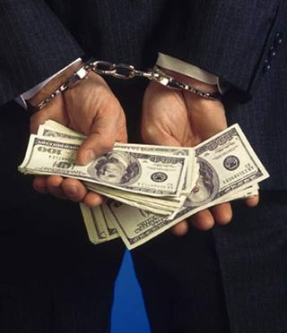

Slide 23
What can Fraud Examiners Do?
Be Honest in Assessing the Situation
  Acknowledge the Promoters’ Skills
  Understand where the tools we use are:
    Disregarded
    Insufficient
    Unused
  Recognize our tools are not working
    and make changes accordingly

Slide 24
What can Fraud Examiners Do?
Confront the
  Challenge of Change
    Regulators
    Investors
    Fraud Examiners
      Move From Forensic Reviews
        To real Due Diligence

Slide 25
What can Fraud Examiners Do?
“Move beyond the reconstruction and provide forward-looking solutions that enable individuals, organizations, and governments to act effectively while reducing the risk of loss and exposure to fraud.”

Slide 26
What can Fraud Examiners Do?
Fraud is not
  An accident
  A Failure of Controls
  Or a Cost of Doing Business
Fraud is a predatory business practice that can be defined, diagnosed and destroyed.

Slide 27
Where we go from here …
Carlo “Charles” Ponzi made these schemes a household name.
His successors have made them the most profitable criminal enterprises ever.
It’s time for professional Fraud Examiners to put them to rest.

Slide 28
Questions & Discussion
24th Annual FIRMA National Risk Management Training Conference
Jonathan E. Turner, CFE, CII

Slide 29
Jonathan E. Turner, CFE, CII
Wilson & Turner Incorporated
901/546-8585
jet@wilson-turner.com

