Slide 1

Distribution Process in Class Action and SEC Settlements
Francis E. McGovern
PROFESSOR OF LAW, DUKE UNIVERSITY
26th Annual
National Risk Management Training Conference
March 25-29, 2012 ● Fort Worth, Texas

Slide 2
Overview
  Description of the distribution process
  Data concerning the distribution process
    Case studies
  Tensions and suggestions

Slide 3
Key Players – Private Class Action Settlements
  Lead plaintiff
  Plaintiff attorney
  Defendant
  Defense attorney
  Judge

Slide 4
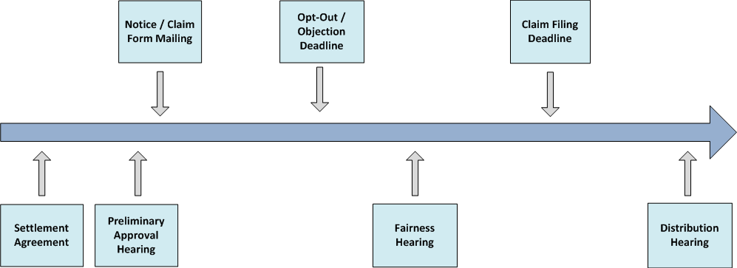
Timeline – Private Class Action Settlements

Slide 5
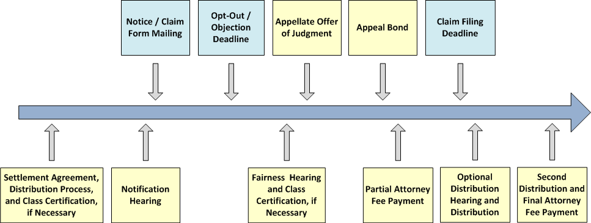
Proposal – Private Class Action Settlements

Slide 6
Key Players – SEC Settlements
  SEC
  Defendant
  IDC
    Claims Administrator
    Economist
    Bank

Slide 7
Timeline – SEC Settlements

Slide 8
Claims Administration Process – Claims Made

Slide 9
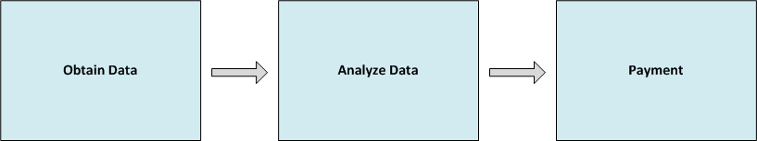
Claims Administration Process– Not Claims Made

Slide 10

Notice / Claim Form Mailing
  Interface with nominees
  Publication in IBD and direct mail
  Alternative media – WSJ, email
  Support Services – helpline, website
  Blank and pre-populated
  claim forms
  Electronic filing option
  for bulk filers

Slide 11

Claim Processing
  Receipt and response rate calculation
  Validity determination
  Deficiency processing
  Fraud prevention and detection
  Payment calculation
    Notification
    Pro rata
    De minimis

Slide 12
Payment
  File approval
  Mailing and wire transfers
  Single payments to bulk filers
  Follow up on undelivered and un-cashed checks
  Payment review/appeal
  process

Slide 13
Participation Rates in Private Securities Litigation Settlement Distributions
    Study: 52 Cases
    Settlement years: 2000-2008
    Analysis:
  2001 - 2004 25
  2005 - 2008 27

Slide 14
Statistical Study Results
  Settlements increased in value
Settlement Distribution Year | Cases | Average Inflation Adjusted Settlement Amount | Median Inflation Adjusted Settlement Amount
2001-2004 | 25 | $70, 410,879 | $12,162,487
2005-2008 | 27 | $343,240,215 | $19,848,665

Slide 15
Statistical Study Results
  Estimated number of potentially eligible shares increased
Distribution Year | Cases | Average Shares Potentially Eligible | Median Shares Potentially Eligible
2001-2004 | 25 | 343,518,934 | 41,972,717
2005-2008 | 27 | 972,312,360 | 125,893,995
 |  | 183% | 200%

Slide 16
Statistical Study Results
  Number of claim forms mailed increased
Distribution Year | Cases | Average Claim Forms Mailed | Median Claim Forms Mailed
2001-2004 | 24 | 225,509 | 26,089
2005-2008 | 24 | 479,950 | 35,069
 |  | 113% | 34%

Slide 17
Statistical Study Results
  Number of eligible claims and shares filed increased
Distribution Year | Cases | Average Eligible Claims | Median Eligible Claims | Average Eligible Shares | Median Eligible Shares | Average Eligible Shares Per Claim | Median Eligible Shares Per Claim
2001-04 | 25 | 36,417 | 4,918 | 198,541,998 | 17,865,250 | 6,549 | 5,260
2005-08 | 27 | 80,285 | 4,995 | 443,720,763 | 48,399,127 | 10,532 | 7,247
 |  | 120% | 2% | 123% | 171% | 61% | 38%

Slide 18
Statistical Study Results
  Electronic claims increased
Claim Filing Deadline Year | Cases | Average Electronic Claims | Median Electronic Claims | Average % Electronic Claims | Median % Electronic Claims
2001-04 | 12 | 10,119 | 293 | 14% | 10%
2005-08 | 18 | 62,540 | 3,336 | 45% | 41%

Slide 19
Statistical Study Results
  Larger settlements, longer filing periods, and more potentially eligible shares resulted in more claims filed
Term | Estimate | Std Error | t Ratio | Prob>|t|
Intercept | -1336184 | 163484.8 | -8.17 | <.0001*
Inflation Adjusted Cash Settlement fund | 31379.196 | 13424.94 | 2.34 | 0.0243*
Filing Window - date from mailing of claim forms to claim filing deadline | 45685.649 | 22570.12 | 2.02 | 0.0493*
Shares Potentially Eligible | 47906.677 | 13197.14 | 3.63 | 0.0008*

Slide 20
Statistical Study Results
  Between 40% and 60% of potentially eligible shares were filed and determined eligible for payment
Distribution Year | Cases | Average % Shares Eligible | Median % Shares Eligible
2001-04 | 25 | 48% | 38%
2005-08 | 27 | 55% | 46%

Slide 21
Statistical Study Results
  Longer class period and larger numbers of eligible shares are associated with a larger percentage of eligible shares paid and more complex plans of distribution are associated with a smaller percentage
Term | Estimate | Std Error | t Ratio | Prob>|t|
Intercept | 0.1992055 | 0.083137 | 2.40 | 0.0216*
Length of Class Period | 0.0859118 | 0.026262 | 3.27 | 0.0023*
Shares per Eligible Claim | 0.0024398 | 0.000993 | 2.46 | 0.0187*
Complex Plans | -0.112444 | 0.06383 | -1.76 | 0.0862

Slide 22
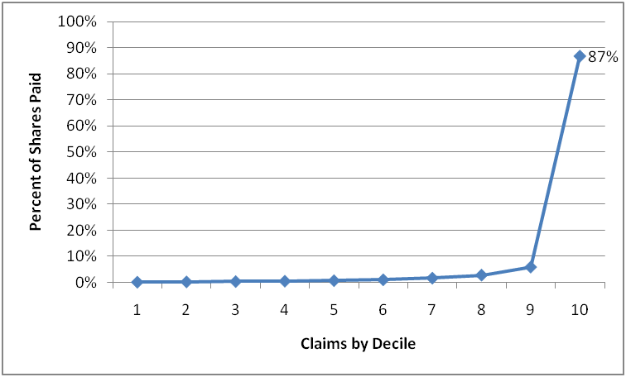
Statistical Study Results
  Approximately 90% of settlement funds are consistently paid to 10% of the claims.

Slide 23
Mass Settlements Often Pose Goldilocks Dilemma

Slide 24
Potential Disaster Scenarios
  Too many opt-outs
  Too few claims
  Too many claims
  Too little money
  Too much money

Slide 25
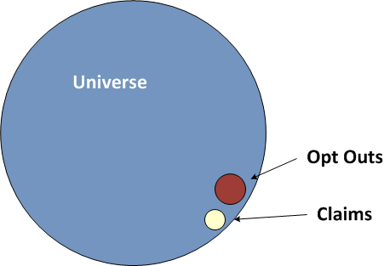
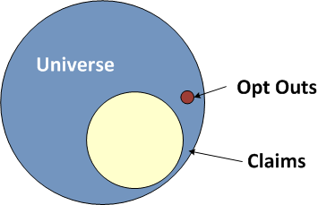
Too Many Opt Outs
  Average Wholesale Price Antitrust Litigation
Status Quo
Judicial Management

Slide 26
Too Few Claims
Global
Fannie Mae

Slide 27
Too Many Claims
  Triana DDT

Slide 28
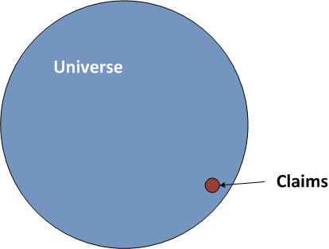
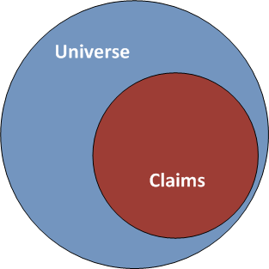
Too Few Claims and Too Many Claims
  Foreign Currency Conversion
Status Quo
Filing Options

Slide 29
Too Little Money
  Stringfellow Pit
Exposure
 | Points
Age
Disease
Flat Amount
Property
Factors
29
Notes:
29

Slide 30
Too Much Money
  Global Research Analyst Settlement
Fund Total
Fund Distribution

Slide 31
Trade Offs
Time | Cost | Quality

Slide 32
Tensions
  Defining data and filing responsibility
    Legal
    Contractual
  Data
    Transaction data retention and transfer
    Account holder contact data retention
  Customer privacy
    Legal
    Contractual

Slide 33
Tensions, Contd.
  Notice/Claim Form Mailing
    Obtaining CUSIPs and other information needed for filing
    Forwarding notice/supplying names and addresses
    Duplication and due process
  Claims Processing
    Deadlines
    Electronic filing
    Deficiencies
    Receipt of claim notification

Slide 34
Tensions, Contd.
  Payment
    Deadlines for depositing monies
    Single and multiple checks/wires
    Claim status disposition
    Shares/warrants distribution
    Un-cashed checks and closed accounts
    Interest

Slide 35
Claim Filing Suggestions
  Establish agreements with clients for filing and data retention/transfer responsibility
      Closed accounts
      New accounts
  Establish financial arrangements with clients
  Establish alternative arrangements
      Filing service
      Self filing
      Other
  Record authority to file internally

Slide 36
Other Suggestions
  Communicate with claims administrators
    Eligibility guidelines
    Electronic filing templates
    Authority to file
    Fraud prevention and data confidentiality
    Wire transfers
    Deficiency codes
    Escheatment

Slide 37
Other Suggestions, Contd.
Arrange needed services from claims administrators
    Notification of receipt of claim
    Disposition of claims filed
    Bulk deficiency processing
    Deadline reminders/advance notice of payment
    Accounting for disbursements from single wire/check

Slide 38
Other Suggestions, Contd.
Seek improvements
    Greater standardization across cases
        Time to file/respond
        Deadline date
    Better organization and timing of information needed for filing
        All CUSIPS
        Corporate actions
        Derivatives eligible

Slide 39
Other Suggestions, Contd.
  Seek improvements, contd.
    Improved processes for bulk filers
        Electronic filing
        Electronic deficiency processing
        Single check/wire
    Changes in Plans of Distribution
        Guidelines on eligibility of purchase alternatives
        Instructions to return un-deposited monies to funds

