Slide 1

Whistleblowing and the new race to report
The impact of the Dodd-Frank Act whistleblowing provision
March 27, 2012
Mohammed Ahmed
Deloitte Financial Advisory Services LLP

Slide 2
Contents
The Dodd-Frank Act
Ten things about whistleblowing
Questions

Slide 3
The Dodd-Frank Act
Section 922 of the Dodd-Frank Wall Street Reform and Consumer Protection Act (Dodd-Frank Act):
  Created awards of 10–30 percent of monetary sanctions for whistleblowers who report to the Securities and Exchange Commission (SEC) original information leading to securities law enforcement actions that recover more than $1 million
  Whistleblowers are allowed to anonymously provide information, but must identify themselves prior to receiving any award.
  Provisions designed to encourage, but not require, employees to use their company’s internal reporting systems. An employee who reports information first through internal company channels and then to the SEC within 120 days would be prioritized for a reward based on the earlier, internal, reporting date. In determining the amount of each reward, the SEC will consider whether a whistleblower effectively used, or hindered, a company’s internal compliance program. Whistleblowers who only report internally may still be eligible for a reward; the SEC will give credit to a whistleblower when a company passes their reported information to the SEC.
  Enhanced whistleblower anti-retaliation protections.
  Note: The Commodity Futures Trading Commission (CFTC) has adopted a similar whistleblower bounty program

Slide 4
Potential impact
More allegations
More people may report directly to the SEC/CFTC
More SEC/CFTC inquiries
More investigations
Less time in which to conduct investigations without regulatory involvement

Slide 5
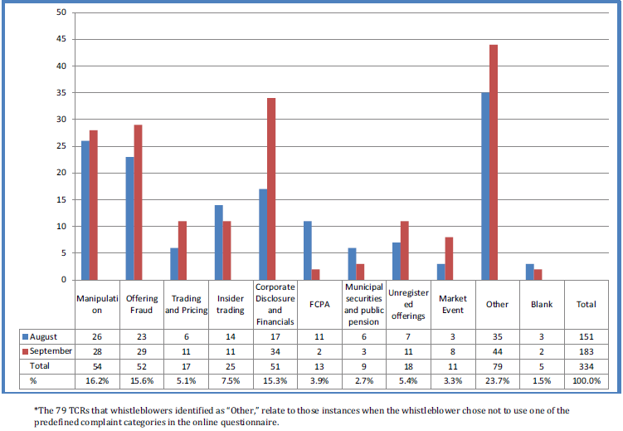
Whistleblower tips by allegation type as reported by the SEC¹
¹2011 U.S. SEC Annual Report on
Dodd-Frank Whistle Blower Program FY11

Slide 6
SEC reveals first eligible cases
The SEC Office of the Whistleblower recently published enforcement actions where whistleblowers are eligible for a reward
Some of the companies on this SEC list include Wachovia Bank, Aon Corporation, Morgan Stanley Investment Management, FTN Financial Securities and Credit Suisse Alternative Capital.
Once the SEC posts a covered action, individuals have 90 calendar days to apply for an award by submitting a completed Form WB-APP by midnight of the action’s due date.
Source: Claim an Award http://www.sec.gov/about/offices/owb/owb-awards.shtml

Slide 7
Questions for financial services organizations
Do you know where your organization’s exposure is to the type of fraud and corruption (eg insider trading, market manipulation, fraudulent financial report) that would typically be reported under these new rules?
    Have you performed a fraud and corruption risk assessment?
Does your whistleblower program as it is currently designed encourage employees to report violations internally? Is it well communicated?
How does this new rule change your approach to decisions relating to self-reporting of potential fraud and/or corruption to regulators (eg SEC/DOJ/CFTC)?
How prepared is your firm for the potential increase in volume of allegations relating to fraud/corruption?
If your employees are highly incentivized to report potential fraud and/or corruption, aren’t you equally incentivized to establish strong anti-fraud/corruption controls?

Slide 8
Ten things about whistleblowing

Slide 9

1. Tips appreciated
No.1 method of fraud detection, per ACFE 2010 Report to the Nations on Occupational Fraud and Abuse.
Entities with hotlines discover 47 percent of frauds through tips, per ACFE.
That still leaves 53% detected by other methods, e.g., transaction testing and internal auditing.

Slide 10

2. Don’t get distracted by noise
Approximately half of whistleblower calls are typically related to personnel issues.
While there may be some ‘noise’ with a whistleblower system, the goal is not to let it distract you from what may be truly important.

Slide 11
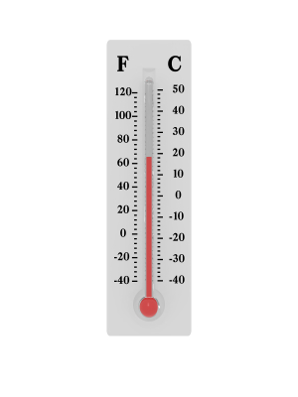
3. Is your hotline just lukewarm?
Seven ways to take your hotline’s temperature:
  Anonymous employee surveys
  Benchmarking
  Focus groups
  Exit interviews
  Feedback from hotline users
  Interviews
  Incident logs

Slide 12

4. Carrots may help you hear better
Rewarding whistleblowers may be necessary to compete effectively with the U.S. government’s rewards for tips relating to securities violations.
Some rewards might be widely published internally; others may be much more sensitive.
Fairness and generosity of rewards may help to attract employee support and generate more reports.

Slide 13

5. Communicate, communicate, communicate
63 percent of employees surveyed said they had reported misconduct when they saw it (2009 National Business Ethics Survey by ERC)
  Maintaining awareness of the system, building willingness to use it, and developing employees’ ability to identify potential wrongdoing
  Publishing internally suitable anonymous examples of where a whistleblower system report led to an investigation and appropriate disciplinary action

Slide 14

6. Protecting those who serve
Creating a supportive environment for whistleblowers can include:
  Developing rewards
  Non-retaliation policy and training
  Monitoring whistleblowers’ career, pay, and proposed discipline
  Investigating alleged retribution
  Implementing a records retention policy for whistleblower reports, complaints, and investigations

Slide 15

7. Open wide
Whistleblower system access can sometimes be restricted consciously by executives who may be fearful of having to respond to more allegations if they “open wide” but doing so may enhance overall results.
Potential barriers to whistleblowing include:
  Service hours – 24x7x365
  Languages – preferred languages of employees and other constituents
  Constituencies – employees, suppliers, customers, and the general public
  Methods – hotline, web form, e-mail, fax, letter and in person.

Slide 16

8. What’s in a name?
‘Whistleblower’ may have negative connotations for cultural, historical, and other reasons.
Two-way communication system called a ‘helpline’ or ‘guideline’ may be less intimidating and can provide guidance before action is taken.
Giving employees experience in using the line for day-to-day matters, building trust, and making them more willing to call should a serious matter arise.

Slide 17

9. When in Rome…
Taking an American whistleblower system and deploying it worldwide without any customization may not generate the desired results.
It can be helpful to involve local personnel to help tailor communication about the system.
Providing alternative reporting methods as well, such as e-mail or Web form, may be much more attractive since they tend to be more popular in certain cultures.

Slide 18

10. A prepared and diligent response
Certain principles can help drive more effective responses, including:
  Clear line of reporting from the whistleblower system to a designated member of senior management with a reporting relationship directly to the board of directors or audit committee
  Defined roles and responsibilities for evaluating incoming reports
  Clear communication processes
  Pre-determined investigation protocols and plans
  Disciplinary committee

Slide 19
What questions do you have?

Slide 20
Contact information
Mohammed Ahmed, CPA, CFF, CCEP
Senior Manager
Deloitte Financial Advisory Services LLP
+1 212 436 4703
mahmed@deloitte.com

Slide 21
This presentation contains general information only and is based on the experiences and research of Deloitte practitioners. Deloitte is not, by means of this presentation, rendering business, financial, investment, or other professional advice or services. This presentation is not a substitute for such professional advice or services, nor should it be used as a basis for any decision or action that may affect your business. Before making any decision or taking any action that may affect your business, you should consult a qualified professional advisor. Deloitte, its affiliates, and related entities shall not be responsible for any loss sustained by any person who relies on this presentation. Certain services may not be available to attest clients under the rules and regulations of public accounting.

Slide 22
About Deloitte
Deloitte refers to one or more of Deloitte Touche Tohmatsu Limited, a UK private company limited by guarantee, and its network of member firms, each of which is a legally separate and independent entity. Please see www.deloitte.com/about for a detailed description of the legal structure of Deloitte Touche Tohmatsu Limited and its member firms. Please see www.deloitte.com/us/about for a detailed description of the legal structure of Deloitte LLP and its subsidiaries. Certain services may not be available to attest clients under the rules and regulations of public accounting.
Copyright © 2012 Deloitte Development LLC. All rights reserved.
Member of Deloitte Touche Tohmatsu Limited
Notes:
21

