Slide 1

“Letters and Titles and Tags, Oh My!”
FIRMA NATIONAL RISK MANAGEMENT
TRAINING CONFERENCE
FORT WORTH, TEXAS
March 25-29, 2012
Presented by:
Janice J. Sackley, CFE Deborah A. Austin, CTCP
Fiduciary Foresight, LLC SVP, Trust Compliance
Fiduciary Compliance and Fraud Consultants Union Bank

Slide 2
Overview of Presentation
Risk Analysis
Regulations/Guidance
Industry Surveys
Employee Perspectives
Policy Making Considerations

Slide 3
Many Questions
Few concrete answers.
Most issues must be considered by your firm and answers will be based on its risk appetite, culture and business environment.

Slide 4
Analysis of Risks
Issues to Consider:
Customer perceptions and expectations
Dual-hatted confusion
Requirements of certain designations
Costs associated with designations
Laws and regulations

Slide 5
Customer Perceptions and Expectations
Understanding of credential: What is it? What expertise is implied?
Will customer hold your firm accountable for expertise of employee? What if services are not rendered pursuant to the designation?
Should employee discuss the credential and what it means with the customer? If yes, how is it presented?

Slide 6
Educational Credentials Commonly Used
MBA JD PhD
Earned through accredited institutions of
higher learning
No continuing education requirements
Can be decades-old
No cost to use or maintain a degree

Slide 7
Industry Certifications
CFP CFA ChFC CSA CSC BCM CkP CAPP CASL CFPN ChFC CTFA CLU CFSA CTCP ADPA AAMS AIF AFC CEBS CEPC CSC PPC PFS

Slide 8
Designations and Certifications
Bona fide designations earned through course of study and examination
May be accredited through American National Standards Institute or National Commission for Certifying Agencies, or included on Department of Education list of “Accrediting Agencies Recognized for Title IV Purposes”
Often require continuing education
Sometimes have disciplinary process
Sometimes have a Code of Ethics
Sometimes require membership in certifying organization to be in “good standing”

Slide 9
Dual-Hatted Confusion
Questions to consider:
Is employee acting within scope of the credential?
Should employee explain or disclose to customer when the activity is or is not within scope?
Is designation also used by employees in other business units of the firm? (example, a CFP may be in trust, broker-dealer, RIA, insurance agency, or family office)

Slide 10
Use of Professional Designation May Impose Duties
May require user to follow certain business practices
May require recordkeeping of complaints and agreements
May require specific customer disclosures
May require registration marks
May elevate relationship to a higher liability level, ie Fiduciary

Slide 11
CFP Standards of Professional Conduct:
1.2 If the certificant’s services include financial planning or material elements of financial planning, prior to entering into an agreement, the certificant shall provide written information or discuss with the prospective client or client the following:
The obligations and responsibilities of each party under the agreement with respect to:
  i. Defining goals, needs and objectives,
  ii. Gathering and providing appropriate data,
  iii.Examining the result of the current course of action without changes,
  iv.The formulation of any recommended actions,
  v.Implementation responsibilities, and
  vi.Monitoring responsibilities.
Compensation that any party to the agreement or any legal affiliate to a party to the agreement will or could receive under the terms of the agreement; and factors or terms that determine costs, how decisions benefit the certificant and the relative benefit to the certificant.
Terms under which the agreement permits the certificant to offer proprietary products.
Terms under which the certificant will use other entities to meet any of the agreement’s obligations.

Slide 12
CFA Standards of Practice Handbook:
VI. CONFLICTS OF INTEREST
A. Disclosure of Conflicts. Members and Candidates must make full and fair disclosure of all matters that could reasonably be expected to impair their independence and objectivity or interfere with respective duties to their clients, prospective clients, and employer. Members and Candidates must ensure that such disclosures are prominent, are delivered in plain language, and communicate the relevant information effectively.

Slide 13
CPWA Certified Private Wealth Advisor Code of Professional Responsibility:
Disclose fully to clients services provided and compensation received. All financial relationships, direct or indirect, between consultants and investment managers, plan officials, beneficiaries, sponsors or any other potential conflicts of interest shall be fully disclosed on a timely basis.

Slide 14
American Institute of CPAs
Fiduciary Standard of Care
A fiduciary has a legal duty to act solely in the best interests of the beneficiary. While an accountant normally is not considered to be a fiduciary to his or her clients, the AICPA Professional Code of Conduct embodies standards of conduct which are closely analogous to a fiduciary relationship—objectivity, integrity, free of conflicts of interest and truthfulness. Accountants who provide audit services cannot be held to a fiduciary standard given their duty to the public.
Courts have found that an accountant can be a fiduciary to his or her client when providing certain professional services including tax services, asset management and general business consulting. Generally, if the following three elements are present in a client relationship, an accountant may be deemed to be a fiduciary to their client: (i) the accountant holds himself or herself out as an expert in an aspect of business, (ii) the client places a high degree of trust and confidence in the accountant and (iii) the client is heavily dependent upon the accountant’s advice. An accountant who provides investment advisory services as a registered investment adviser is a fiduciary to his or her advisory clients.

Slide 15
Regulations and Industry Guidance
State Statutes/NASAA Model
Bank Regulatory Guidance
FINRA Guidance

Slide 16
“Senior Designations”
North American Securities Administrators Association model rule on the use of senior-specific certifications and professional designations adopted March 20, 2008:
(a) use of one or more words such as “senior,” “retirement,” “elder,” or like words, combined with one or more words such as “certified,” “registered,” “chartered,” “adviser,” “specialist,” “consultant,” “planner,” or like words, in the name of the certification or professional designation; and
(b) the manner in which those words are combined.

Slide 17
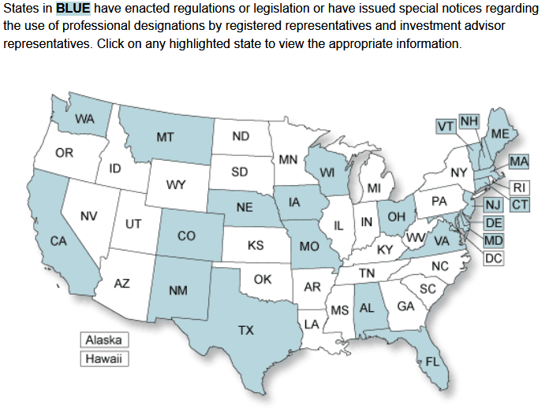
http://www.finra.org/Investors/ProtectYourself/BeforeYouInvest/p120759
©2012 FINRA. All rights reserved.FINRA is a registered trademark of the Financial Industry Regulatory Authority, Inc. Reprinted with permission from FINRA.

Slide 18
State Statutory/Administrative Rules Examples
Florida 69W-600.0133 Use of Senior-Specific Certifications and Professional Designations by Associated Persons and Investment Advisers
Washington State WAC 460-25A-020 Use of Senior-Specific Certifications and Professional Designations
California Dept of Insurance Section 787.1 of Cal. Insurance Code
Colorado 3 CCR 702-1 (insurance sales)
Texas 7 TAC 115.16

Slide 19
Common Elements of State Rules
Most state with statutes or administrative rules generally prohibit the use of designations that:
Are not earned or the person is ineligible; Are nonexistent or self-conferred;
That imply a level of occupational qualification that the person does not possess;
That are obtained from a certifying organization that is primarily engaged in the business of instruction in sales or marketing;
Where the certifying organization does not have standards for assuring competency;
Where the certifying organization does not have reasonable procedures for monitoring and disciplining its certificants for improper or unethical conduct; and
Where there is no continuing education requirement for continued use of the designation.

Slide 20
California rule lists certain designations as prohibited from use by insurance agents.
“Common senior designations not approved. These designations may not be used by agents and brokers in any oral or written communication from which a sale of insurance to a senior may directly or indirectly result.” [787.1(i) Table B]
CRFA Certified Retirement Financial Advisor
CSA Certified Senior Advisor
CSS Certified Senior Specialist

Slide 21
Bank Regulatory Guidance
NO written guidance found.
However, banking regulators may choose to enforce fair consumer treatment under the unfair or deceptive acts or practices (UDAP) provisions of section 5 of the Federal Trade Commission Act.

Slide 22
FINRA GUIDANCE
Regulatory Notice 11-52 issued November 2011:
FINRA is publishing this Notice to remind firms of their supervisory obligations
regarding the use of certifications and designations that imply expertise,
certification, training or specialty in advising senior investors (senior
designations). This Notice also outlines findings from a survey of firms and
highlights sound practices used by firms with respect to senior designations.
Firms are encouraged to adopt the practices that are outlined in this Notice to
strengthen their own supervisory procedures, as appropriate to their business.

Slide 23
FINRA Regulatory Notice 07-43
Obligations to Seniors
Firms that allow the use of any title or designation that conveys an expertise in senior investments or retirement planning where such expertise does not exist may violate NASD Rules 2110 and 2210, NYSE Rule 472, and possibly the antifraud provisions of the federal securities laws. In addition, some states prohibit or restrict the use of senior designations.

Slide 24
Finra Notice 07-43:
Firms Must Have Supervisory Procedures
These supervisory procedures must be:
In writing
Clearly communicated to employees
Effectively enforced
Include how “approved designations” may be used

Slide 25
While not mandated, Finra highlights certain activities as best practices, including annual employee attestations for registered persons to certify:
Which designations they use;
That those designations are earned;
That they have fulfilled continuing education requirements to use the designation; and
That they are in good standing with the credentialing organization.

Slide 26
SEC Sect 208(c)
Investment Advisers Act of 1940
Restricts the title of “investment counsel” unless the individual is an investment adviser:
(c) It shall be unlawful for any person registered under section 203 of this title to represent that he is an investment counsel or to use the name ‘‘investment counsel’’ as descriptive of his business unless (1) his or its principal business consists of acting as investment adviser, and (2) a substantial part of his or its business consists of rendering investment supervisory services.

Slide 27
SEC Form ADV, Part 2B Brochure Supplement
The SEC requires registered investment advisors to prepare, file, and provide to customers a Brochure Supplement to the Form ADV. This supplement includes the educational background and business experience of supervised persons. The instructions specifically include direction with respect to professional designations as follows:

Slide 28
FINRA Conducted Survey*
In 2011, Finra conducted a survey of retail broker-dealers regarding the use of “senior designations”. Of the 157 respondents, 68 percent of the firms allowed the use of senior designations.
Of great interest is that of those firms that permit their use, 66% require firm approval in order to use the designation AND the firm verifies the employee’s credentials.
Further, 73% of those that permit use, prohibit ed the use of certain senior designations.
*Survey results reported in Finra’s Regulatory Notice 11-52, November 2011 and in a separate report “Senior Designations”.

Slide 29
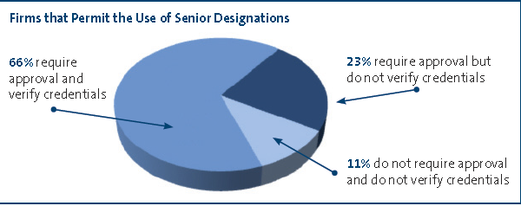
2011 FINRA Survey of BD Firms
©2012 FINRA. All rights reserved.FINRA is a registered trademark of the Financial Industry Regulatory Authority, Inc. Reprinted with permission from FINRA.

Slide 30
Those firms that limit employees to using only certain designations used various criteria to select them:
Curriculum
Continuing education requirements
Public disciplinary process
Existence of Code of Ethics
Ability for public to verify credentials

Slide 31
Informal Bank Survey
Small informal survey taken of a several banks. Most banks permitted the use of industry certifications and degrees, with only a couple having written policies.
Most did not permit the use of “Esquire” for those with Juris Doctor degrees unless the employee works in the Law Department. One bank had a similar rule for M.D.s and R.N.s.
If your firm allows J.D. to be used by those not acting as attorneys for the bank, a prudent practice would be to have a disclosure that no legal advice is being provided if the employee is public facing.

Slide 32
Employee Perspectives
Employees take pride in maintaining and upgrading their knowledge in their fields, and have put in a lot of hard work to earn valid and worthwhile credentials. Public display of designations on business cards and stationery is a form of recognition of this effort. Your firm should consider employee morale when making any policy regarding credentials, including how they may enhance:
Employee Achievement
Credibility with customers and peers
Knowledge level
Differentiate your employee from competitors
Respect as an Expert
Pride
Reward

Slide 33
Ten Questions to Answer if you pursue a designation/credential policy.
Will you permit all financial industry designations, or only selected ones?
Will you devote resources to performing due diligence on designation programs?
Will you verify that an employee has actually earned the designation?
Will you pay for an employee to enroll in a designation program?
Will you pay for continuing education?
Will you pay for membership fees?

Slide 34
Ten Questions…
Will you permit clerical level employees, or those in other divisions not related to service delivery, to use or pursue credentials?
Will you permit paid time off for continuing education?
Will you require any type of disclosure for customer materials, especially where the credential reflects a role not assumed by the employee (JD, CPA, or, for example, a CFA who is a trust officer)
Will you require a periodic attestation from employees about their use of designations?

Slide 35
Contact Information
Jan Sackley
jan@fidfore.com
269-323-8119
Deborah Austin
Deborah.Austin@unionbank.com
619-230-3526

