Slide 1

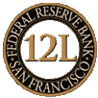
Federal Reserve Bank of San Francisco
FIRMA Risk Management Training Conference
Fort Worth, Texas
March 25-29, 2012
Regulator Panel
March 27, 2012
William Alverson, Fiduciary Risk Coordinator
Federal Reserve Bank of San Francisco
Banking Supervision & Regulation

Slide 2
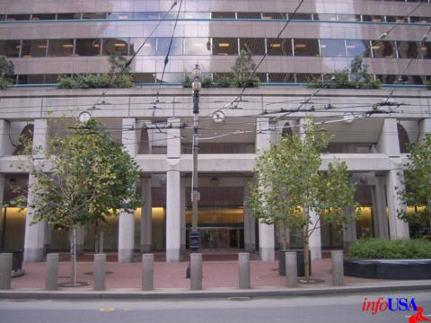
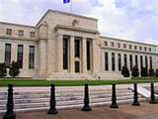
Federal Reserve Bank of San Francisco
Disclosure: The views and opinions expressed herein are those of my own and do not represent the official opinions of the Federal Reserve Bank of San Francisco, my colleagues in the Federal Reserve System, or of the Federal Reserve System Board of Governors.

Slide 3
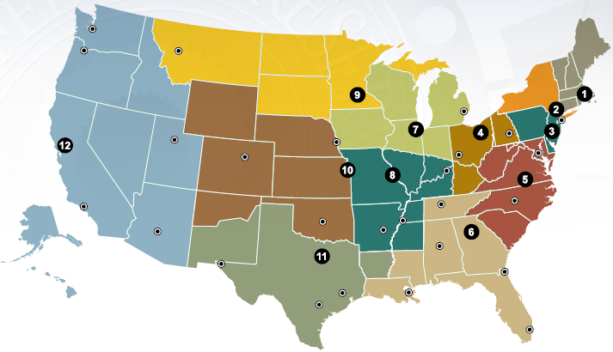
Federal Reserve Bank of San Francisco
Board of Governors, Washington DC – Policy
12 Regional Federal Reserve Banks – Supervisors
Federal Regulator of FHC’s, BHC’s, SLHCs, FBOs, and SMBs

Slide 4
Federal Reserve Bank of San Francisco
FDIC Insured Institutions by Supervisor (FDIC, OCC, Fed)
(FDIC Quarterly Banking Profile – 3Q 2011)
 | Number of Institutions | Total Assets ($ B) | Domestic Deposits ($ B)
Commercial Banks | 6,352 | $12,560 | $7,582
FDIC Supervised | 4,193 | $1,982 | $1,512
OCC Supervised | 1,333 | $8,727 | $4,926
Fed Supervised | 826 | $1,851 | $1,144
Savings Institutions | 1,084 | $1,248 | $923
OCC Supervised | 636 | $923 | $678
FDIC Supervised | 448 | $325 | $245
Bank Holding Companies - Fed Supervised | 4,784 | $17,480 | NA

Slide 5
Federal Reserve Bank of San Francisco
Federal Reserve Mission – Banking Supervision & Regulation:
Promote the safety and soundness of the banking system and compliance with laws and regulations
How:
Focus on financial institutions’ business strategy, financial condition, risk management processes, and corporate governance
Ongoing supervision/surveillance & early identification of emerging risks
Conduct risk-focused examinations to assess safety & soundness, regulatory, and fiduciary compliance
Initiate when necessary supervisory actions (MRIA, MRA, Observation) and, if necessary, initiate, monitor, and terminate enforcement actions
Process applications (mergers, acquisitions, etc.)

Slide 6
Federal Reserve Bank of San Francisco
System Governance – Wealth Management
FR System Fiduciary & Insurance Affinity Groups
2011/2012 Wealth Management Top Supervisory Themes
  BHC Asset Management Exposures - Advised and Sponsored Investment Funds
  Integrated BHC Wealth Management Platforms
  Operational Risk Management (including IT & AML)
    Corporate & Consumer Compliance
  Legal Risk and Corporate Governance
    Fiduciary Responsibilities & Fair Play Standards
  Dodd-Frank Act Considerations
    Umbrella Holding Company Supervisor
    Broker/Dealer/RIA/Other Nondepository Subsidiaries

Slide 7
Federal Reserve Bank of San Francisco
  BHC Asset Management Exposures - Advised and Sponsored Investment Funds (Registered & Common/Collective)
Supervisory Rationale – “Near Zero” Rate Environment; New Financial Rules/Regulations; Liquidity Strains & Capital Loss; Suitability and Complexity of Products
Holistic BHC Risk Management Framework – Enhance Understanding of Enterprise-Wide Exposures
    Total Asset Management Activity
    Institutional Asset Management Compositions
    Concentrated Investment Strategies
    Past/Present Amount of BHC/Bank Financial Support (including fee waivers)
    Investment Fund Management
        Poor Performance in Advised/Sponsored Investment Funds
        Stresses of Continued Low Rate Environment
        Stressed Investments – Municipalities, Euro Debt, etc
        Break the Buck” Fund Support Expenses & Fee Waivers

Slide 8
Federal Reserve Bank of San Francisco
Integrated Wealth Management Platforms
    Many Regional (RCBO) and Large Banking Organizations (LBO) now deliver financial products to their retail and corporate/institutional clients through functionally managed “lines of business” (LOB). Many employees are dual officers of bank, B/D, RIA, and other legal entities
  Management of Various Product Delivery Venues; Holistic Capture/Reporting of “Cross-Entity” Risk; Conflicts of Interest Management ; Legal Entity Capacity & Corporate Governance
  Functional Regulators/Reporting Requirements/Fiduciary and Standards of Care Similarities and Differences
BHC
Broker-Dealer
Bank
Investment Advisor
Insurance
Investment Advisor
Investment Advisor
Financial Advisors
Trust Company

Slide 9
Federal Reserve Bank of San Francisco
  Operational Risk - Various
  RCBO/LBO Enterprise Risk Management. All entities subject to prudent risk management standards (SR95-51)
  LBO > $50 Billion Subject to SR08-8 Integrated Compliance Risk Management Programs
    Firmwide Approach to Compliance RM & Oversight
    Independence of Compliance Staff
    Compliance Monitoring & Testing
    BOD & Senior Management Responsibilities – RE: RM & Oversight
  State-Member Banks/Trust Companies
    Mandated Trust Exams & MOECA Assessments
    NDIP, Regulation R/GLBA Push Out Rules
  BSA/AML, IT Security, Applications, Reconcilements

Slide 10
Federal Reserve Bank of San Francisco
  Legal Risk and Corporate Governance
Legal and Reputational Risks – Management Oversight & Corporate Governance. All actions related to financial products, and services provided are undertaken as directors, officers, and/or employees of specific legal entities with the accompanying corporate governance trappings, responsibilities, and liabilities. Legal entities “deliver” products not functional lines of business
Institutions must understand and incorporate appropriate delivery, capacity, fiduciary responsibilities, and fair play standards when designing, marketing, and delivering financial products and services:
    Delivery – legal entity offering product or service (i.e. bank, investment bank, broker/dealer, RIA). Type of delivery channel will determine applicable regulations and standards of conduct.
    Capacity – role of legal entity in regards to product/service. For example, trustee, principal/dealer, broker/agent, or seller/buyer
    Fiduciary Responsibilities - understand and appreciate legal responsibilities and fiduciary duties of trustees, principals/dealers, agents/broker dealers versus marketplace sellers and buyers.

Slide 11
Federal Reserve Bank of San Francisco
  Legal and Corporate Governance (Continued)
Legal Entity Capacity & Responsibilities:
    Trustees/Fiduciaries – typically held to the highest standard of conduct and trust. Must always act in best interests of beneficiaries
    Agents/Brokers – act on behalf of a principal (individual or institution) who hired them to perform a specific task or function (i.e. find my the best home loan or suitable investment). Agents have limited fiduciary responsibilities to their principal and should disclose potential and real conflicts of interest.
    Principal/Dealer – sell or buy from their own book, as opposed to brokers, who on behalf of principals, sell or buy from others and get paid by commission/markup.
    Buyers and Sellers in the Financial Marketplace – generally have no fiduciary responsibility. Caveat Emptor – let the buyer beware, but sellers must play fair

Slide 12
Federal Reserve Bank of San Francisco
  Legal and Corporate Governance (Continued)
  Fair Play – its required by law. Section 5(a) of the Federal Trade Commission Act prohibits “unfair or deceptive acts or practices in or affecting commerce, and applies to all persons engaged in commerce, including BHCs and their subsidiaries. Enforced by:
    Banking Regulators (including CFPB), SEC/SROs
    Fair Trade Commission (“FTC”)
    State Attorneys Generals (State Laws and Regulations)
  Unfair and Deceptive Acts and Practices (UDAP) – new supervisory focus on UDAP. Technical compliance may not always be sufficient. More focus on ensuring informed decisions and overall product life cycle integrity.
    Unfair Acts or Practices - An act or practice is unfair when: it causes or likely causes substantial injury to consumers. Substantial injury usually involves monetary harm
  Dodd-Frank Act Expanded Powers - UDAP– Section 1031 – Bureau of Consumer Financial Protection (CFPB) may prescribe rules to identify unlawful, unfair, deceptive or abusive acts or practices in connection with any consumer financial product or service

Slide 13
Federal Reserve Bank of San Francisco
  Dodd-Frank Act (DFA) Considerations
Expanded FR’s Objectives as Consolidated Supervisor. New holding company framework and supervisory objectives are to:
  Ensure that a BHC/SLHC subsidiary does not present material financial, legal, or reputational risks to affiliated depository institutions, or the ability of the BHC/SLHC to provide support to those subsidiary depository institutions
  Incorporate financial stability, as well as enhanced prudential considerations of DFA, into consolidated supervision objectives and approaches
  Reflect lessons learned from framework during financial crisis, including experience with the supervision of nondepository subsidiaries; and
  Extend the framework to SLHCs and nonbank financial companies designed as systemically important by the Financial Stability Oversight Council

Slide 14
Federal Reserve Bank of San Francisco
  Dodd-Frank Act (DFA) Considerations (Continued)
DFA Sections 604 & 605
    FR will regularly consult with supervisor(s) of an organization’s lead depository institution to identify significant risk taking activities.
    For nondepository institutions supervised by a functional regulator, FR will consult and coordinate with to promote comprehensive and effective supervision
  DFA Section 604 removed the so-called “Fed Lite” requirements of GLBA. FR is to still rely to the fullest extent possible on information and assessments of relevant functional regulators
  DFA Section 605 introduced new expectations for FR supervision of activities at nondepository subsidiaries that are not functionally regulated.
    When deemed appropriate, FR supervisory staff have explicit authority to direct an organization to apply risk management or internal control standards to nondepository and nonregulated subsidiaries

Slide 15




Federal Reserve Bank of San Francisco

Slide 16
Federal Reserve Bank of San Francisco
THE END

