Slide 1
How to React and Survive
A Crisis
Marcia N. Keeler
Corporate Counsel and First Vice President
MB Financial Bank, N.A.
March 29, 2012

Slide 2
Disclaimer
This presentation does not reflect the views or opinions of the organization represented by the presenter. This presentation has not been approved, disapproved, or otherwise acted upon by any regulatory or legal body and is provided for your education and insight. This presentation should not be construed as professional advice, nor does it constitute a recommendation to achieve compliance with any applicable laws or regulations. If you wish to pursue compliance initiatives based upon this presentation, you must review and analyze the applicable laws and regulations and seek professional advice, as appropriate.

Slide 3
Outline
What is a Crisis?
Crisis Management
Crisis Mismanagement
Response Plan
Communications
Post Crisis Self Evaluation

Slide 4
Crisis Definition
When does an event trigger Crisis Management Plan?
ISSUE
EMERGENCY
CRISIS

Slide 5
What is a Crisis?
An action or event that has a reasonable likelihood of generating SUBSTANTIAL financial or reputational harm.

Slide 6
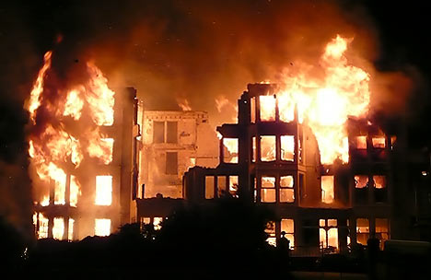
What is a Crisis?
A Major Event
Natural – Earthquake , fire, hurricane, blizzard, tornado, flood, tsunami, landslide.

Slide 7
What is a Crisis?
Technological
  Non-routine failures of our technological systems. A “non-routine” failure means there is an unplanned system shut down or interruptions in services for a significant period of time which results in a real, obvious, and negative impact on our business operations. Technological crisis may include communication failures, electrical failures, HVAC failures and/or loss of information systems.

Slide 8
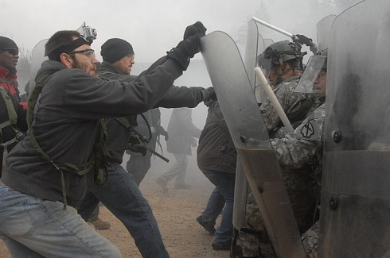
What is a Crisis?
Human
Terrorist attack, bomb threat, civil disturbance, and/or unexpected loss of senior management personnel.

Slide 9
What is a Crisis?
Marketplace/Legal
Material violation of stock exchange rules, losing the company’s status as an exchange-listed company, stock volatility – i.e. wild swings in the stock price, unfavorable publicity (whether true or not), criminal and other government investigations, hostile takeover attempts by other companies, significant legal actions like large, multimillion dollar lawsuits, and regulatory investigations.

Slide 10
Working Definition of Crisis Management
Practices, procedures and policies that are used to handle, contain, and resolve emergency situations in a planned way.
Good crisis management requires identifying threats to the organization and its stakeholders.

Slide 11
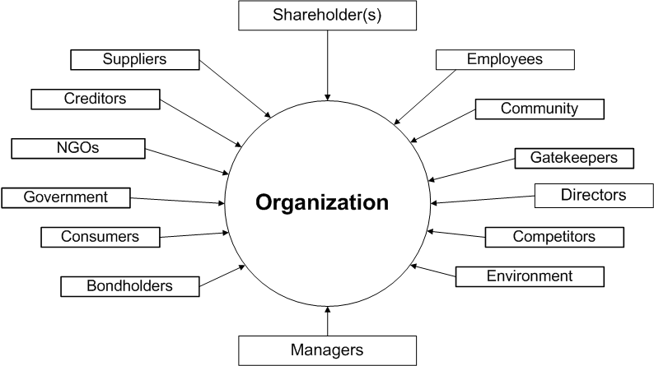
Working Definition of Crisis Management

Slide 12
Mismanaging a Crisis
Absence of a plan
Inadequate or inappropriate implementation of a plan
Absence of honesty, open communication and involvement of the top individuals within the company
Displaying lack of commitment to customers
Significant financial and non-financial consequences
  Devaluation of shares, reputation damage, loss of revenue, loss of human resources, failure to achieve entity’s performance and profitability targets

Slide 13
Examples of Crisis Mismanagement
Sienna Food Ltd.
  Ontario based company
  Faced class actions after a recall order by the Canadian Food Inspection Agency and the Ontario government started investigating its deli meat
  Company’s response: silence
Menu Food Income Fund
  Major product recall of wet dog and cat food across North America in 2007
  Response: “held back information”, had “big fights with plaintiff counsels in class actions, “ended up changing the names of some of its products, so some product lines just died out.”

Slide 14

Examples of Crisis Mismanagement
American International Group, Inc. (AIG)
  Liquidity crisis at the centre of the 2008 financial crisis
    Credit ratings downgraded below “AA” levels
  Hank Greenberg, chief executive accused of document destruction and theft
  Eliot Spitzer, New York’s attorney general, forced the company to fire the world’s most experienced risk manager
  Meetings and concern for risk management came to a halt after Mr. Greenberg left
  AIG plunged into crisis

Slide 15
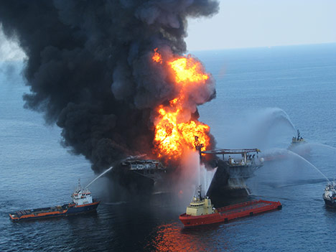
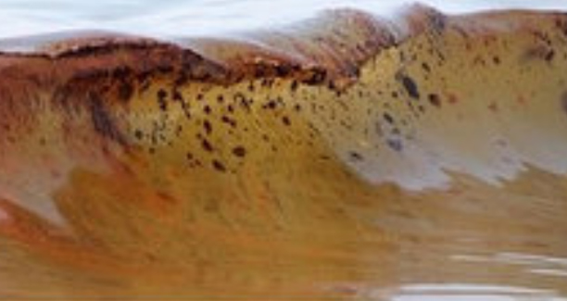
BP’s Tony Hayward: ‘I Want My Life Back’
“…the board of directors failed to understand that the [Tony] Hayward regime had not addressed BP’s most serious safety issues at operational levels deep in the company – not withstanding chart presentations at board meetings.”
(BusinessWeek column, July 2010)
“Better management of decision-making processes within BP…would have prevented Macondo incident.” (White House Commission Report, Jan. 2011)

Slide 16
Response Plan
Appointment of a Crisis Response Team
Activate Crisis Action Plan
  Plan must include a provision for communication of consistent and accurate information
  Plan must outline the priorities, activities, responsibilities, timelines and communication needs

Slide 17
Response Plan
Regardless of the type of crisis, the plan should ALWAYS include the following guidelines:
    The designated Corporate Spokesperson is the only team member who should make statements to the news media

Slide 18
Response Plan
Call Center staff and all other employees should be courteous to media but should refer media calls directly to the Media Contact, who would work with the Corporate Spokesperson to provide the company’s response

Slide 19
Response Plan
Speculations and opinions are ABSOLUTELY prohibited by team members to anyone outside the team. This is CRITICAL and all employees should be made aware that providing speculative comments or opinions to anyone will result in severe consequences

Slide 20
Response Plan
A log of all media calls, public opinion calls/letters and visits to the property related to the emergency should be maintained and would include a record of what was said to each reporter

Slide 21
Response Plan
Assess the situation
Who needs to be contacted – determine notification procedure, i.e., call tree, crisis website
Start with initial, pre-prepared outline of procedures to be followed
Continuously update current Crisis Plan throughout event

Slide 22
Response Plan
Fact sheets, information resources, copies of press releases, etc., should be captured and attached to Plan in real time
Media training for Senior Executives
Practice Plan annually
Review Plan regularly and circulate updates to key staff

Slide 23
Crisis Communications
Media Communication Steps
  Issue a public response
  Use a holding statement
  Ensure alignment with legal strategy
  Document all media communications

Slide 24
Crisis Communications

Slide 25
Crisis Communications
Legal Reminder
All parties, including counsel, should operate under the assumption that all communications and factual work product will ultimately be disclosed to the government and/or third-party litigants at some time in the future.
Documents, including emails, should be restricted to factual communications.

Slide 26
Crisis Communications
Communications Dos and Don’ts
  Be proactive with the media
  Never let errors go unchallenged
  Speak to your audience
  How much communication is too much?

Slide 27
Crisis Communications
Communications Dos and Don’ts
  Show your concern
  Detail your responsible actions to your key audience
  Demonstrate your cooperative attitude
  Show your resolve to do the right thing

Slide 28
Post Crisis Self Evaluation
Within two weeks of the incident the team should meet and review the Plan:
    What worked
    What didn’t work
    What to implement differently
    Is long term support/counseling necessary?
    Should day-to-day procedural changes be made?
    Create summary document

Slide 29
Thank you
Marcia N. Keeler
(847) 653-1780
mkeeler@mbfinancial.com

