Slide 1

Risk Assessments/Risk Appetite
Judith Gruenbaum

Slide 2


Slide 3

REPUTIONAL
COUNTERPARTY
COMPLIANCE
OPERATIONAL
INTEREST RATE
INDUSTRY CONCENTRATION
LEGAL
PRICE
FOREIGN EXCHANGE
CREDIT

Slide 4
Definitions
  Risk
    exposure to the chance of injury or loss
    a hazard or dangerous chance
  Assessment
    the act of estimating or judging the value or character; evaluation
  Appetite
    a desire or liking for something; fondness; taste

Slide 5
Benefits of an Effective Risk Assessment
  Assesses the financial institution’s risk profile (BSA/AML, Privacy, Fair Lending, LOB)
  Enables the financial institution to apply the appropriate risk management processes to the applicable Compliance program to mitigate risk
  Allows management to better identify and mitigate gaps in the organization’s compliance controls
  Provides a comprehensive analysis of the applicable risk in a concise and organized presentation

Slide 6
Primary Audiences
  Executive Compliance Management
  Executive Business Management
  Risk Committees or similar forums
  Auditors
  Compliance Testing Personnel
  Supervisors/Regulators

Slide 7
  Elements of an Effective Enterprise-wide Risk Management Program
  Dynamic and proactive
  Consolidated understanding of risk exposure
  Coordinated risk management
  Assess evolving risks when new business lines or activities are added
      or when existing activities and processes change
      or when regulatory requirements change
  Deficiencies in one area may indicate a concern in another area – be sure to look across the organization

Slide 8
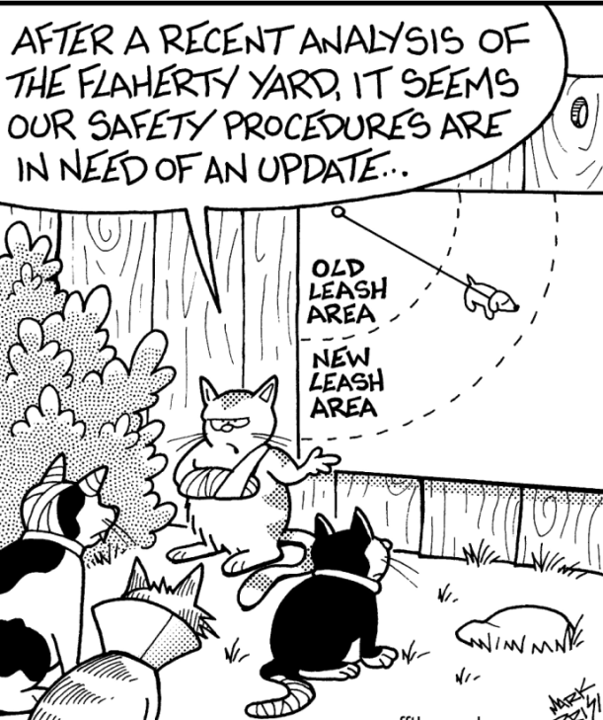

Slide 9
Compliance Risk Assessment Framework
Identify
Measure
Control
Monitor
Identify Applicable Regulatory Requirements
Establish change control processes
Measure risk against consistent compliance risk rating definitions.
Updates to risk ratings as warranted by changes in risk environment (e.g., significant business changes, regulatory focus, audit/exam/compliance testing results, etc.)
  Establish an appropriate control environment based on identified risks
Link Compliance Testing and Audit plans to identified risks

Slide 10
Assess and Quantify Inherent Risk
  Products
  Clients
  Geography (Domestic or International Exposure)
  Forward Looking – changes in business strategy; new products, expanding to new markets, or exiting products/markets

Slide 11
Quantify Compliance Controls
  Governance
  Management Oversight/Resources
  Customer/Client Identification and Due Diligence
  Management Information Systems
  Regulatory Reporting (e.g. CTRs, SARs)
  Training
  Testing/Audit Coverage/Examination Findings

Slide 12
Summarize the Results
Profile of the business
Key Inherent Risk Factors
Primary factors that contributed to the risk levels assigned
Key Mitigation Factors/Controls
Factors that contributed to the strength or weakness of controls
Residual Risk
Direction of Risk Trend
  Where is your risk headed in the next 12-18 months?
  Increasing? Decreasing? Stable?
  Why?

Slide 13
Money Laundering Risk Assessment and MitigationComunicate the Results
Communicate the Results
Communicate the Results
Regulators
Auditors
BSA/AML Officer
Risk
Assessment
Results
Testing Units
Senior/Exec
Management
Risk
Committees

Slide 14
Do’s and Don’ts
DO
  If you want it to count, then write it down!
  Create a workable template and framework including written procedures and guidance
  Invest in the technology
  Use the risk assessments
    Drive/Focus Resources
    Training
    Monitoring
    Independent testing or Audit
      Scoping/Planning
      Validating the Assessment and Controls
  DON’T
  Believe anyone that says there is one right way to do it
  Think of this as a once a year compliance exercise
  Put it on the shelf and forget about it
  Forget to document the analysis portion

Slide 15


