Slide 1
Ethical Walls
(formerly known as the Chinese Wall…)
Today’s View

Slide 2
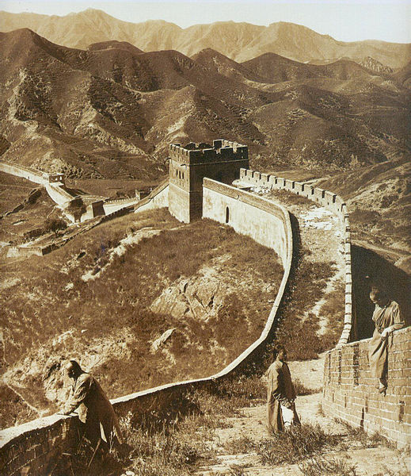
The “Chinese Wall” – what is it?
Public Domain Photo

Slide 3
The Great Wall of China
Longest “building” on earth
Runs for several hundred miles east to west across northern China
Built throughout a number of years
Purpose was to protect the borders of China from invading people
  …but that’s probably not exactly what you’re looking for here!

Slide 4
Objectives for the hour:
Gain an understanding of what is meant by a “Chinese” or an “ethical wall.”
Understand the historical purpose for these walls
Understand how these walls might look today and the applicability of the concept in today’s environment.
And, how to evaluate or assess controls in your company.

Slide 5
A word about nomenclature…
We have historically used the term “Chinese Wall” routinely to identify the information barriers that we will be discussing today.
There is some evidence surfacing that people are beginning to take offense to the term, so…
We will refer to it herein as an “ethical wall”.

Slide 6
Understanding the Wall
In order to fully understand the concept of an ethical wall, one must first understand exactly what we are attempting to “contain” within, or protect against, via adoption of a wall.
Following the market crash of 1929, Congress enacted the Securities Act of 1933 and the Securities Exchange Act of 1934, both specifically aimed at preventing abuses that contributed to the crash.

Slide 7
SEC action against insider trading
Insider Trading is addressed by the SEC in the 34 Act:
  Directly under section 16(b) prohibiting directors, officers, and majority shareholders from profiting off of short term swings in market price within a six month period, and
  Indirectly under section 10(b) which prohibits securities fraud. To implement section 10(b), the SEC adopted Rule 10b-5.

Slide 8
SEC Rule 10b-5 or 17 CFR 240.10b-5
§ 240.10b-5 Employment of manipulative and deceptive devices.
It shall be unlawful for any person, directly or indirectly, by the use of any means or instrumentality of interstate commerce, or of the mails or of any facility of any national securities exchange,
(a) To employ any device, scheme, or artifice to defraud,
(b) To make any untrue statement of a material fact or to omit to state a material fact necessary in order to make the statements made, in the light of the circumstances under which they were made, not misleading, or
(c) To engage in any act, practice, or course of business which operates or would operate as a fraud or deceit upon any person,
in connection with the purchase or sale of any security.

Slide 9
Does 10b-5 actually address insider trading?
Rule 10b-5 generally prohibits fraud.
It is the position of the SEC that making use of nonpublic, inside information to execute a securities transaction in the markets is in actuality a fraudulent act against all others who are holding or effecting trades in the subject security.
Courts have consistently upheld this position.

Slide 10
Definition of Insider Trading
“Trading that takes place when those privileged with confidential information about important events use the special advantage of that knowledge to reap profits or avoid losses on the stock market, to the detriment of the source of the information and to the typical investors who buy or sell their stock without the advantage of ‘inside’ information.”
(From comments by Melissa A. Robertson
then, Associate Director, Division of Enforcement, SEC 1998)

Slide 11
Other notes on enforcement:
Nonpublic information may emanate from a company, company employees, or simply from knowledge about significant trading plans.
Remember, it is the misuse and not simply the possession of inside or nonpublic information that is problematic (and illegal).
The SEC is working aggressively in this area of illegal activity. They allocate a significant portion of their resources to insider trading abuses. Investigation of insider trading abuses will always net congressional and public support!

Slide 12
SEC’s active enforcement
Rajaratnam (Galleon Group LLC)
Spencer Mindlin (Goldman Sachs)
DeCinces (Retired Baseball Player)
Donald L. Johnson (former Managing Director of NASDAQ)
Expert Networks
Deloitte Partner
Kluger
Anthony Chiasson (Level Global)

Slide 13
Why have ethical walls?
The SEC has always encouraged action by financial companies to prevent passing nonpublic information and/or to prevent the usage of such information when employees acquire nonpublic information in the course of their normal duties pursuant to employment with the firm.
Suspected misuse can be overcome where there is evidence supporting the absence of misuse.
Given the strong public opinion, reputation risk attached to trading abuses are significant.

Slide 14
Possible arguments against maintaining ethical walls
Ethical walls, in actuality, do not effectively restrict passage of information or restrict employee trading activities.
Ethical walls are expensive to support and don’t provide strong evidence of effectiveness.
Not technically required under statute or regulation.

Slide 15
Applicability to functions within financial institutions today
Two general areas where oversight and control are important:
where employees encounter nonpublic information in conjunction with their duties, and
where investment discretion is exercised and trades are executed in an environment because it is known that inside information may be encountered.

Slide 16
Where should we find ethical walls?
Start with the Code of Ethics – every financial institution should incorporate robust guidance and strict standards into the corporate Code of Ethics. This will:
  serve to educate employees, and
  make clear to employees (and “other inquirers”) the position of the company, and
  document ample warning for the necessary disposition of cases when abusive action is encountered.

Slide 17
Where should we find ethical walls?
-continued
The Insider Trading prohibitions in the Code of Ethics should:
  Clearly define inside and nonpublic information,
  Prohibit communication and/or improper usage of nonpublic information,
  Explain the parallel between the provisions of the Code and federal law and regulation,
  Detail potential penalties for non-compliance.
Ensure that all employees are provided education that will help them understand the nature of material nonpublic information, the limitations on usage, and the potential risk to the company and to the individual in the event such information is used inappropriately.

Slide 18
Where should we find ethical walls?
-continued
Ethical walls should also be developed within departmental policy and procedure where nonpublic information might be encountered or improperly leveraged.
Departmental policy limitations should be more closely aligned with the specific business activities.
Consider personal trading restrictions and/or programs providing for review and pre-approval of personal trades, where appropriate.

Slide 19
Reviewing ethical walls
Evaluate all business activities to determine the probability of encountering nonpublic information. Any area where financial or other corporate information is requested from, or voluntarily provided by, publicly traded companies should be analyzed.
Ensure that proper policies are in place to caution employees about the confidentiality of information that may be encountered and the related limitations under the Code of Ethics and the law.

Slide 20
Reviewing ethical walls
-continued
Ensure that policies, procedures, and (to the extent practicable) physical controls prevent any unnecessary communication of confidential information to any party both inside or outside of the line of business.
Identify support team members (IT, operational, legal, etc.) who may encounter confidential information pursuant to their job functions and ascertain that policy and internal control coverage is clearly applied to their activities.

Slide 21
Reviewing ethical walls
-continued
Where employees routinely encounter nonpublic information as part of their job function, consider implementation of personal trading restrictions and/or corporate trading oversight programs.
Identify any area of financial activity that involves making investment decisions and/or executing trades on behalf of the company or on behalf of any third party.

Slide 22
Reviewing ethical walls
-continued
Ensure that policies and procedures provide clear guidance on understanding and identifying information that might be nonpublic and the prohibitions on using it in making investment decisions.
Procedures should provide for actions to take when nonpublic information is inadvertently communicated or received. Self-disclosure to appropriate control officials, recusal, and potential trading suspensions may be included as components of these procedures

Slide 23
Conclusion
Ironically the Great Wall of China, though erected to keep enemies out, wasn’t very effective. The Mongols repeatedly crossed over or otherwise breached the Wall during the Ming Dynasty.
Similarly, our namesake control structures are in reality more conceptual and may certainly be breached, particularly when the lure of money is involved.

Slide 24
Conclusion
While ethical walls can’t ensure total protection, they are still a good idea and highly recommended.
Illegal insider trading is seen as a significant threat to our open market system and repulsive to our society. Law enforcement, regulators and our Court system are all vigorously searching out and penalizing those who violate that standard.
Any perceived lack of controls or failure to attempt to prevent an occurrence of illegal insider trading might present immeasurable reputation risk exposure for your institution.

